Slide 1

CAREER SELECTION WEBSITE
Vidya Vikas Education Trust’s
Universal College of Engineering, Vasai(E)
|a website which provides detailed information
about various career options

Slide 2
Group members
NAMES ROLL NO
Gauri Bhirud 09
Jatan Darji 18
Shubh Kuvawala 40
Ansh Mangukia 44
Tejashree Mestry 46
UNDER THE GUIDANCE OF : MR.UMESH MOHITE

Slide 3
INTRODUCTION
In an ever-evolving world, choosing a career path can feel like a tough decision. Should you follow your passion? Align with market demand? Perhaps consider a mix of both? Career selection is an important stage in a student's life. It influences a number of decisions that he/she takes based on their career choices. Choice of a subject, a university, an institution, a company, a job profile depends on the career one chooses to pursue. Career decisions start with self reflection on what is most important to you. This may include your career desires, abilities, personality and assets. By understanding important aspects of yourself, you gain clarity surrounding career decision making. Other People and Other Factors may influence your career direction.
We understand that every individual’s journey is unique, and we aim to help them to make the right decision.

Slide 4
PROBLEM STATEMENTS & OBJECTIVES
Choosing a career after college is a big decision that is done early on in life. Students encounter many problems when it comes to choosing the right career.
Here are some of the major problems that many students
face while choosing a career :
lack of guidance , financial conditions, making decisions under peer pressure, fear of failure.
Because of this a lot of students end up choosing the wrong career rather than one that brings them passion.

Slide 5
PROBLEM STATEMENTS & OBJECTIVES
Our OBJECTIVE is to make students select career according to their :
Passion and Interest : Selecting a career that aligns with your passions and interests can be highly motivating. When you love what you do, you're more likely to excel in your chosen field and find fulfillment in your work.
Financial Stability: Financial considerations often play a significant role in career selection. The prospect of earning a comfortable income and achieving financial security can be a strong motivator.
Skills and Talents : Recognizing your skills and talents and applying them in your career can be highly motivating. When you're naturally good at something and can leverage those skills in your work, it can lead to a sense of achievement and success.

Slide 6
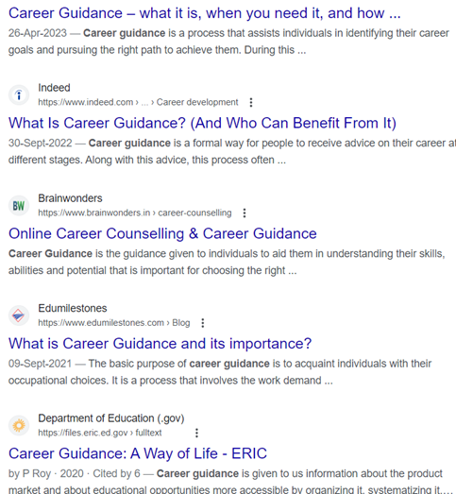
LITERATURE SURVEY
various websites that have the same purpose as us
There already exist various websites which have the same goal as us . So you might be thinking what's so special about this website same thing, same knowledge just a different interface right ?? BUT no ... here's where our website stands out then any other already available.
• Unlike other websites, you won't have to juggle between multiple tabs just to find out which college u want according to your interest. All the information will be loaded into one place .
• The most inconvenient thing about a website are those useless ads popping up on the screen just to disturb you in your work . We can surely tell there will be zero ads popping up . No disturbance, better focus and you're already halfway there in choosing your next best thing

Slide 7
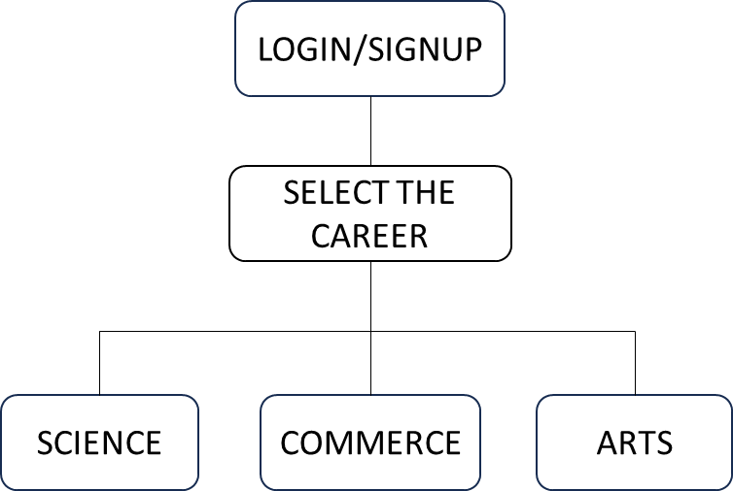
PROPOSED SYSTEM
The main purpose of making this career selection website is to help students to select the appropriate career path for them.
Figure-1
Additional feature of our site is that one can also see the future scope of that particular career and choose accordingly.
Every single piece of information will be available on our website so that a student doesn’t have to juggle between different websites.

Slide 8
SYSTEM ARCHITECTURE
1.ENGINEERING
2.DOCTOR
3.SCIENTIST
1.CHARTERED ACCOUNTANT
2.COMPANY SECRETARY
1.JOURNALISM
2.PHOTOGRAPHY
3.FASHION DESIGNING
Figure-2

Slide 9
PROJECT MODULES
The proposed system consists detailed overview of careers :
1. SCIENCE
- eg. Research Scientist, Healthcare Professional)
2. COMMERCE
- eg. Chartered Accountant, Investment Banker)
3. ARTS
- eg. Aviation, Tourism, Media, Entertainment)

Slide 10
FUTURE SCOPE
The internet allows career development websites to reach a global audience, So if someone from other country wants to know about the career opportunities in our country , they can easily do so using our website. As industries become more specialized, there's a growing demand for career development platforms tailored to specific sectors or professions. These platforms can provide industry-specific insights, job postings, and networking opportunities. Overall, the future of career development websites is bright, driven by technological advancements, changing work dynamics, and the increasing need for lifelong learning and skill development in a rapidly evolving job market. The digital landscape is evolving and career websites are the first thing someone will check to see all the new changes. As technology, work culture and job seeker preference changes, career websites will need to adapt and update as well with all the new emerging career options.

Slide 11
REQUIREMENTS
FUNCTIONAL REQUIREMENTS
NON-FUNCTIONAL REQUIREMENTS
SOFTWARE REQUIREMENTS
Html
Css
HARDWARE REQUIREMENTS
a computer
atleast 8GB RAM

Slide 12
CONCLUSION
The first step to solving a career problem is to bridge the gap between where you are and where you want to be. Exploring your values, interests, and skills will help you find educational and career options that match up with your goals. Whether you are choosing a major, searching for a job, or applying to grad schools, our theory-based services can help you develop and implement a plan for the future. Through this website we will try our best to help the students ease their career selection process. Also it will help the future generations to acquire the knowledge, information, skills, and experience necessary to identify career options, and narrow them down to make one career decision. This career decision will then results in their social , financial and emotional well-being throughout.

Slide 13
THANK YOU

